Slide 1
BU7150 — Business Decision Optimization
Introduction to Optimization
Linear Programming
Dr. Isilay Talay
Assistant Professor in Operations and Supply Chain Management
Date 01/31/2023

Slide 2
Introduction to Optimization
Optimization in a nutshell
Business Decision
Optimization
Best
Under limitations

Slide 3

Module Leader
Dr. Isilay Talay – talayi@tcd.ie
Experience
Trinity Business School
Assistant Professor of Operations and Supply Chain Management
Programme Co-Director for MSc OSCM
School of Business and Social Sciences, Antalya Bilim University
Assistant Professor of Business Administration
Department Chair of Business Administration
Duke University Medical Research Center
Database Management and Healthcare Operations Project
Education
Duke University Fuqua School of Business
PhD in Operations Management
Koc University
MSc in Industrial Engineering
Istanbul Technical University
BSc in Industrial Engineering
Research Interests
Optimal coordination of traditional and blockchain-based international fund transfer systems, supply chain finance with random yield and lead time, optimal staffing in specialized education

Slide 4
What is optimization?
and the perspective of the practitioner
“optimization, also known as mathematical programming, collection of mathematical principles and methods used for solving quantitative problems in many disciplines, including physics, biology, engineering, economics, and business. The subject grew from a realization that quantitative problems in manifestly different disciplines have important mathematical elements in common. Because of this commonality, many problems can be formulated and solved by using the unified set of ideas and methods that make up the field of optimization.” Stephen J. Wright, https://www.britannica.com/science/optimization
General principles and solution methods
Being practiced via deduction
Evolved via Induction
Specific problems in different contexts and the solutions found
Specific problems in need of solutions and following business decisions

Slide 5
Use of optimization
Examples of use in business functions as well as other contexts
Optimization
Decisions
Best (e.g. to achieve the maximum or to consume the minimum)
Under limitations (or constraints)
Examples
Context: Consumer products, Entertainment Industry, Healthcare, Fast Food, Social Media, Banking, Services, Government
Business Functions: Customer Service, Supply Chains, Operations, Transportation, Manufacturing

Slide 6
Optimization in Business Analytics
Optimization in Prescriptive Analytics
Databases and Data Warehousing
In-depth understanding of company and products
Data retrieving and deploying
Descriptive Analytics
Descriptive Statistics
Real-time analysis and reporting
Predictive Analytics
Forecasting
Data Mining
Discovering patterns and extract knowledge
Prescriptive Analytics
Optimization
Make decisions
Asllani, A. Business Analytics with Management Science Models and Methods, Chapter 1 , Figure 1-1

Slide 7
Optimization in Business Analytics
Optimization in Prescriptive Analytics – Example: Online movie ticket seller
Databases and Data Warehousing
Capturing information about customers, movie theatres, ticket sales, and show times; then extract, transform, and load into data warehouses
Descriptive Analytics
Descriptive Statistics
Correlation among sales for different movies
Predictive Analytics
Forecasting
Data Mining
Which customers more likely to buy the ticket and when
Prescriptive Analytics
Optimization
Optimal price, updated dynamically
Asllani, A. Business Analytics with Management Science Models and Methods, Chapter 1 , Figure 1-1

Slide 8
Optimization Methods
Linear Programming – Example: Insulation Production
From Lecture Reading ‘Note on Linear Programming’, p. 1-2:
https://hbsp.harvard.edu/tu/eb9a4c2d
Three stages of reading:
1) What is the business function and context of application? What is the role of the decision maker?
Daily production planning by the plant manager in a manufacturing environment (insulation production)
2) What is the ‘best’ we are trying to achieve? What are our limitations? What do we need to decide to create our production plan?
We are trying to maximize the total contribution from the production plan, under limited production capacity, loading capacity, and raw material availability. How much to produce from each product, i.e. type B and type R?

Slide 9
Optimization Methods
Linear Programming – Example: Insulation Production
From Lecture Reading ‘Note on Linear Programming’, p. 1-2: https://hbsp.harvard.edu/tu/f37a6266
Three stages of reading:
3) How can we express these descriptions in stage 2 mathematically so that we can enter them into an optimization software and solve our production planning problem?
Decisions: How can I quantify my decision on how much type B and type R to produce? Need to use symbolic notation since I do not know the answer yet, and I need to choose my unit of quantification carefully (e. g. in tons or truckloads?)
b truckloads of type B
r truckloads of type R

Slide 10
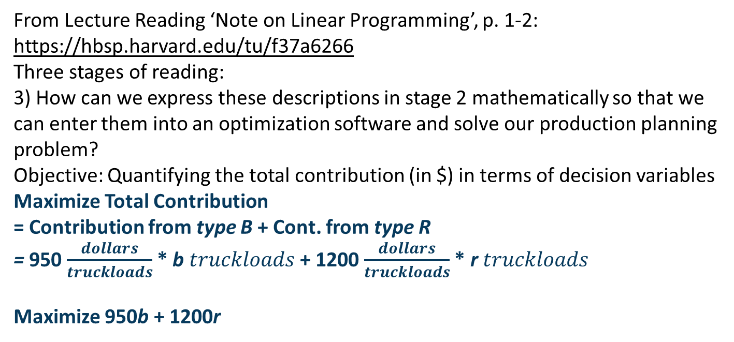
Optimization Methods
Linear Programming – Example: Insulation Production
From Lecture Reading ‘Note on Linear Programming’, p. 1-2: https://hbsp.harvard.edu/tu/f37a6266
Three stages of reading:
3) How can we express these descriptions in stage 2 mathematically so that we can enter them into an optimization software and solve our production planning problem?
Objective: Quantifying the total contribution (in $) in terms of decision variables
Maximize Total Contribution
= Contribution from type B + Cont. from type R
= 950 $\frac{dollars}{truckloads}$ * b $truckloads$ + 1200 $\frac{dollars}{truckloads}$ * r $truckloads$
Maximize 950b + 1200r

Slide 11
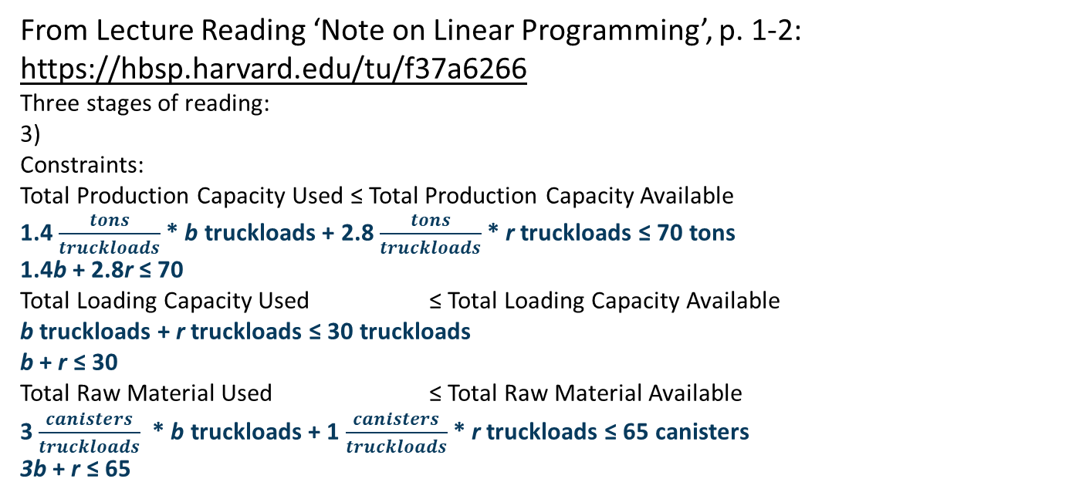
Optimization Methods
Linear Programming – Example: Insulation Production
From Lecture Reading ‘Note on Linear Programming’, p. 1-2: https://hbsp.harvard.edu/tu/f37a6266
Three stages of reading:
3)
Constraints:
Total Production Capacity Used ≤ Total Production Capacity Available
1.4 $\frac{tons}{truckloads}$* b truckloads + 2.8 $\frac{tons}{truckloads}$* r truckloads ≤ 70 tons
1.4b + 2.8r ≤ 70
Total Loading Capacity Used ≤ Total Loading Capacity Available
b truckloads + r truckloads ≤ 30 truckloads
b + r ≤ 30
Total Raw Material Used ≤ Total Raw Material Available
3 $\frac{canisters}{truckloads}$ * b truckloads + 1 $\frac{canisters}{truckloads}$* r truckloads ≤ 65 canisters
3b + r ≤ 65

Slide 12
Optimization Methods
Linear Programming – Example: Insulation Production
From Lecture Reading ‘Note on Linear Programming’, p. 1-2: https://hbsp.harvard.edu/tu/f37a6266
Three stages of reading:
3)
Constraints:
Production amount cannot be negative
b ≥ 0
r ≥ 0
Maximize 950b + 1200r
subject to 1.4b + 2.8r ≤ 70
b + r ≤ 30
3b + r ≤ 65
b ≥ 0
r ≥ 0

Slide 13
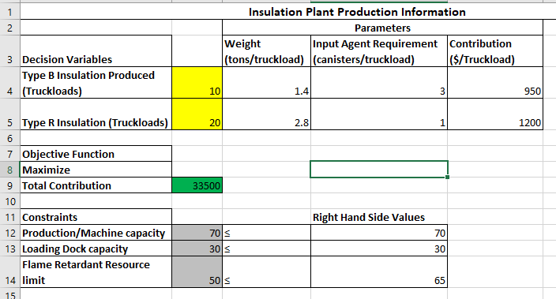
Optimization Methods
Linear Programming (LP) – Example: Insulation Production
From Lecture Reading ‘Note on Linear Programming’, p. 1-2: https://hbsp.harvard.edu/tu/f37a6266
Solution via Excel Solver add-in
Decision maker, Carla, the plant manager and her responsibilities and how LP can help do her job better:
Ex: https://resources.workable.com/plant-manager-job-description
https://www.indeed.com/hire/job-description/plant-manager

Slide 14
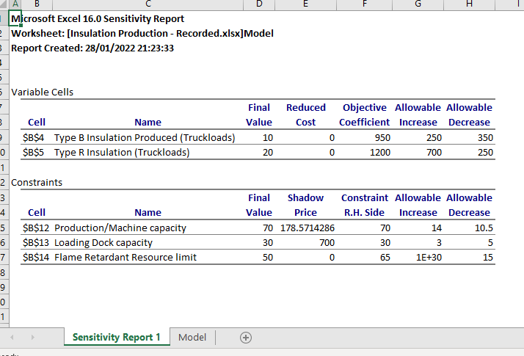
Optimization Methods
Linear Programming (LP) – Example: Insulation Production
From Lecture Reading ‘Note on Linear Programming’, p. 1-2: https://hbsp.harvard.edu/tu/f37a6266
Solution via Excel Solver add-in
Decision maker, Carla, the plant manager and her responsibilities and how LP can help do her job better:
What-if we have more production capacity?
What-if we have more loading capacity?

Slide 15
Module-level Learning Outcomes
1. Explain the concept of optimisation and multicriteria decision making
2. Structure optimization and simulation problems to analyse complex business environments and decisions
3. Develop spreadsheet models to represent optimization and simulation problems
4. Solve and interpret results of spreadsheet models to determine best courses of actions
5. Increase awareness of the scope of business environments and functions optimization and simulation could be applied as prescriptive analytics tools

Slide 16
Workload and Assessments
Final Exam 40% - Multiple Choice, Problem, Open-ended (Tentative)
Group Assignment 60% - Two parts: mathematical programming, simulation
- Problem/Case Study, Open-ended
- Ideally 5 members, and at least 1 PC user
Excel add-ins runs most efficiently in PCs
Supplemental Assessment: 100%
Are model elements correct and complete?
Efficiency in using Excel
Interpretation of the results, What-if scenario creation, arriving at solid recommendations

Slide 17
Textbooks and Required Resources
Recommended textbooks:
Taylor, B. W. III. (2019). Introduction to Management Science. 13th ed. Pearson.
Asllani, A. (2014). Business Analytics with Management Science Models and Methods. FT Press.
Albright, S. C., & Winston, W. L. (2020). Business analytics: Data analysis & decision making. Cengage Learning.
Harvard Business Publishing Education cases and articles

Slide 18
A Blend Example
Chapter 4: Taylor, B. W. III. (2019). Introduction to Management Science. 13th ed. Pearson.
bbl: barrel of crude oil

Slide 19
A Blend Example
Determine the optimal mix of the three components in each grade of motor oil that will maximize profit. Company wants to produce at least 3,000 barrels of each grade of motor oil.
Decision variables: The quantity of each of the three components used in each grade of gasoline (9 decision variables); x_{ij} = barrels of component i used in motor oil grade j per day, where i = 1, 2, 3 and j = s (super), p (premium), and e (extra).
Chapter 4: Taylor, B. W. III. (2019). Introduction to Management Science. 13th ed. Pearson.

Slide 20
A Blend Example
Decision variables: The quantity of each of the three components used in each grade of gasoline (9 decision variables); x_{ij} = barrels of component i used in motor oil grade j per day, where i = 1, 2, 3 and j = s (super), p (premium), and e (extra).
Super: x_{1s} + x_{2s} + x_{3s} bbl
Premium: x_{1p} + x_{2p} + x_{3p} bbl
Extra: x_{1e} + x_{2e} + x_{3e} bbl
Chapter 4: Taylor, B. W. III. (2019). Introduction to Management Science. 13th ed. Pearson.

Slide 21
A Blend Example
Objective function: Maximize profit = Revenue - Cost
Maximize Z = (Revenue from Super + Revenue from Premium + Revenue from Extra) – (Cost of Component 1 used + Cost of Component 2 used + Cost of Component 3 used)
Maximize Z = 23 (x_{1s} + x_{2s} + x_{3s}) + 20 (x_{1p} + x_{2p} + x_{3p}) + 18 (x_{1e} + x_{2e} + x_{3e} ) – 12 (x_{1s} + x_{1p} + x_{1e}) – 10 (x_{2s} + x_{2p} + x_{2e}) – 14 (x_{3s} + x_{3p} + x_{3e})
Maximize Z = 11x_{1s} + 13x_{2s} + 9x_{3s} + 8x_{1p} + 10x_{2p} + 6x_{3p} + 6x_{1e} + 8x_{2e} + 4x_{3e}
Chapter 4: Taylor, B. W. III. (2019). Introduction to Management Science. 13th ed. Pearson.

Slide 22
A Blend Example
Constraints:
Total # available barrels per day for each component
Ratio constraints
Minimum amount of production
Nonnegativity Constraints
Total # available barrels per day for each component
x_{1s} + x_{1p} + x_{1e} ≤ 4,500 bbl.
x_{2s} + x_{2p} + x_{2e} ≤ 2,700 bbl.
x_{3s} + x_{3p} + x_{3e} ≤ 3,500 bbl.
Chapter 4: Taylor, B. W. III. (2019). Introduction to Management Science. 13th ed. Pearson.

Slide 23

A Blend Example
Ratio constraints (for Super)
$\frac{x_{1s}}{x_{1s} +{ x}_{2s} +{ x}_{3s}}$ ≥ 0.50
$x_{1s}$ ≥ 0.50 ($x_{1s} +{ x}_{2s} +{ x}_{3s}$)
0.50 $x_{1s}$ - 0.50 ${ x}_{2s}$- 0.50 ${ x}_{3s}$ ≥ 0
$\frac{x_{2s}}{x_{1s} +{ x}_{2s} +{ x}_{3s}}$ ≤ 0.30
-0.30 $x_{1s}$ + 0.70 ${ x}_{2s}$- 0.30 ${ x}_{3s}$ ≤ 0
Chapter 4: Taylor, B. W. III. (2019). Introduction to Management Science. 13th ed. Pearson.

Slide 24

A Blend Example
Ratio constraints (for Premium)
$\frac{x_{1p}}{x_{1p} +{ x}_{2p} +{ x}_{3p}}$ ≥ 0.40
$x_{1p}$ ≥ 0.40 ($x_{1p} +{ x}_{2p} +{ x}_{3p}$)
0.60 $x_{1p}$ - 0.40 ${ x}_{2p}$- 0.40 ${ x}_{3p}$ ≥ 0
$\frac{x_{3p}}{x_{1p} +{ x}_{2p} +{ x}_{3p}}$≤ 0.25
-0.25 $x_{1p}$ - 0.25 ${ x}_{2p}+$ 0.75 ${ x}_{3p}$ ≤ 0
Chapter 4: Taylor, B. W. III. (2019). Introduction to Management Science. 13th ed. Pearson.

Slide 25

A Blend Example
Ratio constraints (for Extra)
$\frac{x_{1e}}{x_{1e} +{ x}_{2e} +{ x}_{3e}}$ ≥ 0.60
$x_{1e}$ ≥ 0.60 ($x_{1e} +{ x}_{2e} +{ x}_{3e}$)
0.40 $x_{1e}$ - 0.60 ${ x}_{2e}$- 0.60 ${ x}_{3e}$ ≥ 0
$\frac{x_{2e}}{x_{1e} +{ x}_{2e} +{ x}_{3e}}$ ≥ 0.10
-0.10 $x_{1e}$ + 0.90 ${ x}_{2e}−$ 0.10 ${ x}_{3e}$ ≥ 0
Chapter 4: Taylor, B. W. III. (2019). Introduction to Management Science. 13th ed. Pearson.

Slide 26
A Blend Example
Minimum amount of production
x_{1s} + x_{2s} + x_{3s} ≥ 3,000 bbl.
x_{1p} + x_{2p} + x_{3p} ≥ 3,000 bbl.
x_{1e} + x_{2e} + x_{3e} ≥ 3,000 bbl.
Nonnegativity Constraints
all xij ≥ 0
Chapter 4: Taylor, B. W. III. (2019). Introduction to Management Science. 13th ed. Pearson.

Slide 27
A Blend Example
Maximize Z = 11x_{1s} + 13x_{2s} + 9x_{3s} + 8x_{1p} + 10x_{2p} + 6x_{3p} + 6x_{1e} + 8x_{2e} + 4x_{3e}
subject to:
x_{1s} + x_{1p} + x_{1e} ≤ 4,500 bbl.
x_{2s} + x_{2p} + x_{2e} ≤ 2,700 bbl.
x_{3s} + x_{3p} + x_{3e} ≤ 3,500 bbl.
0.50x_{1s} - 0.50x_{2s} - 0.50x_{3s} ≥ 0
0.70x_{2s} - 0.30x_{1s} - 0.30x_{3s} ≤ 0
0.60x_{1p} - 0.40x_{2p} - 0.40x_{3p} ≥ 0
Chapter 4: Taylor, B. W. III. (2019). Introduction to Management Science. 13th ed. Pearson.

Slide 28
A Blend Example
0.75x_{3p} - 0.25x_{1p} - 0.25x_{2p} ≤ 0
0.40x_{1e}- 0.60x_{2e-} - 0.60x_{3e} ≥ 0
0.90x_{2e} - 0.10x_{1e} - 0.10x_{3e} ≥ 0
x_{1s} + x_{2s} + x_{3s} ≥ 3,000 bbl.
x_{1p}+ x_{2p} + x_{3p} ≥ 3,000 bbl.
x_{1e}+ x_{2e} + x_{3e} ≥ 3,000 bbl.
all x_{ij} ≥ 0
Chapter 4: Taylor, B. W. III. (2019). Introduction to Management Science. 13th ed. Pearson.

Slide 29
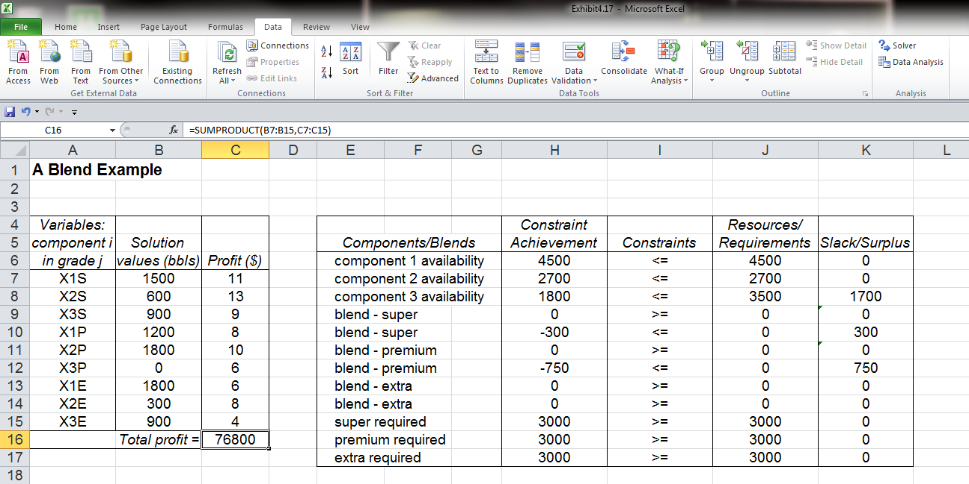
A Blend Example
=B7+B10+B13
Decision variables—B7:B15
=B7+B8+B9
=0.5*B7-0.5*B8-0.5*B9

Slide 30
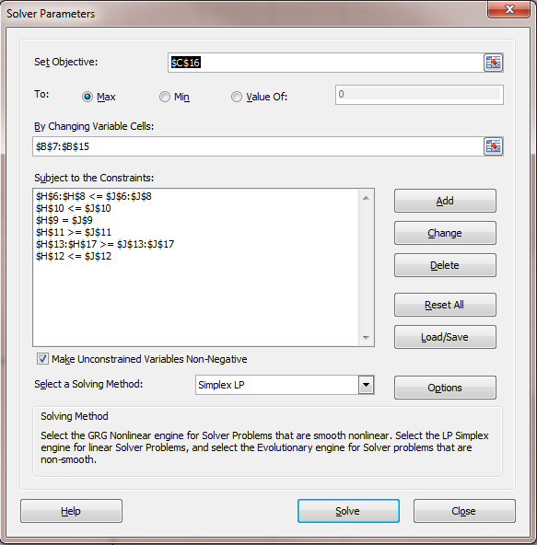
A Blend Example
Exhibit 4.18

Slide 31
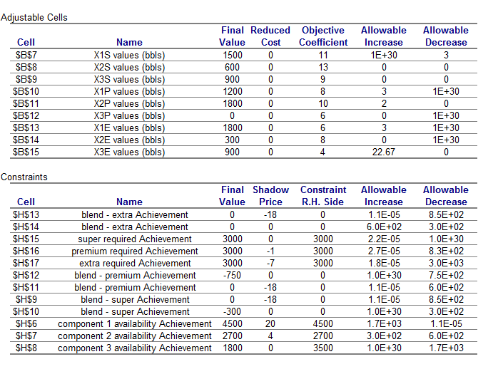
A Blend Example
The upper limit for the sensitivity range for component 1 is 4500+1700=6200.
The shadow price for component 1 is $20.
Chapter 4: Taylor, B. W. III. (2019). Introduction to Management Science. 13th ed. Pearson.

Slide 32
Linear Programming (LP)
Example — Primer Manufacturer Inc. Production Mix
*Weekly production mix of 48 different paint primers (in gallons)
*Aim to maximize contribution
*Weekly available machine hours (8,500)
Contractual agreements imposing min (200 gallons) and max (1200 gallons) amounts for each primer
Budget limitation for raw materials ($90,000)
This problem has a broader scope such that some parameters need to be calculated, which is more realistic. ‘ch3_PaintPrimer – Data.xlsx’
Asllani, A. Business Analytics with Management Science Models and Methods, Chapter 3

Slide 33
Post-Lecture Practice
Rolls Bakery Production Runs
Political Advertisement Agency
Landhills Winery (as a first step, assume the decision variables do not need to be integer, we will refer to this case in the later weeks, too)

